Slide 1
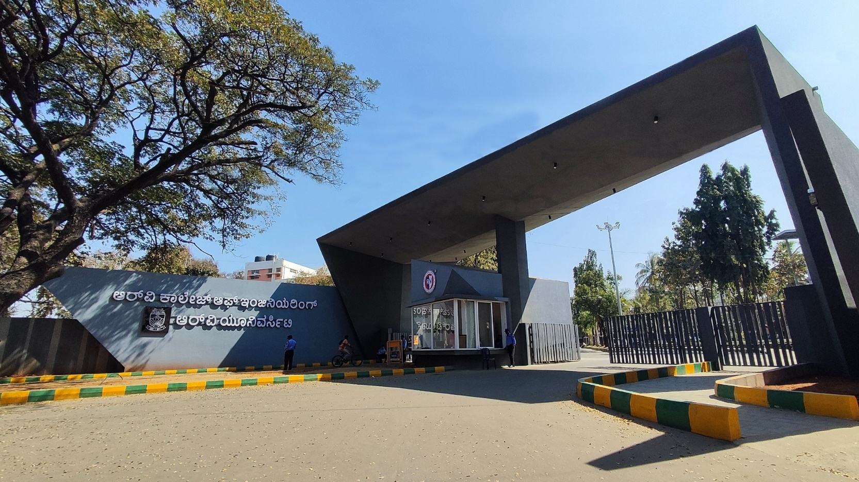
Title of the Presentation
Theme & Project Number

Slide 2
SMART ENERGY METER
Navaneeth V
Chidanand Gowda
Kamma Rohan
Bomgonda Vishal

Slide 3
EL Phase-II Presentation Outline
Introduction
Project Overview
Comments during EL Phase-I and action taken.
Tools and Techniques Used
Project Progress
Analysis of Partial Results
Deliverables and Outcomes
Future work (Remaining tasks)
Conclusion

Slide 4
Introduction
Overview of the topic: Briefly introduce your topic; explain what it is about and why it matters.
Objectives of the current phase and the role it plays in achieving the overall project goals.

Slide 5
Project Overview
Problem statement: What specific challenge or problem does the project aim to address?
Primary objectives of the project and its relevance to the field or industry.
Expected impact or contribution of the project.

Slide 6
Project Overview
Problem Definition:
Traditional meter do not provide real time energy usage consumption as they provide energy usage data over a period of time.
Expected impact:
By providing real-time data and insights, they enable consumers to make informed decisions and thereby reduce energy usage.

Slide 7



Comments during EL Phase-I and action taken
Lack of technicality in objectives and lack of details in methodology
Researched more into the specifics for implementation of project

Slide 8
Tools and Techniques Used
List of tools, technologies, and techniques employed during Phase-II (e.g., software, hardware, materials).
Rationale behind choosing these specific tools (e.g., effectiveness, precision, industry standards).
Any innovative or cutting-edge tools/techniques incorporated into the project.
Screenshots, images, or diagrams of tools/technologies used.

Slide 9
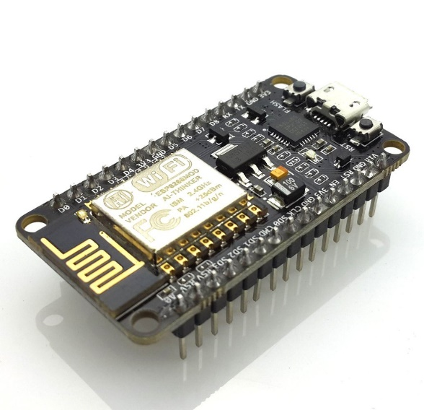


Tools and Techniques Used
Software used:
ESP8266 module
Sensors (Voltage and Current)
Blynk
Arduino IDE

Slide 10
Tools and Techniques Used

Slide 11
Project Progress
Initial prototype completed

Slide 12
Deliverables and Outcomes
List the key deliverables completed so far (e.g., reports, models, prototypes, simulations).
Describe the quality and scope of these deliverables.
How these outcomes contribute to the larger goals of the project.
Visual documentation: Include images or screenshots of completed deliverables, prototypes, or models.

Slide 13
Timeline for Future Works
Designing the app interface (1 week)
Implementing the app design (2 weeks)
Connecting the frontend to a database(2 weeks)

Slide 14
Conclusion
Summarize the progress made in Phase-II and its alignment with the project’s overall objectives.
Reflect on the impact of the current work and how it sets the stage for Phase-III.
Acknowledge contributions, support, or any collaborative efforts involved in the project.
Mention any final takeaways or insights gained from the phase.

